Slide 1
Diamond Data Analysis
By: Vandana Anand

Slide 2

Problem Identification
The purchase of diamonds is culturally significant in today’s society. They are most purchased as an engagement ring or a gift for a loved one for special occasions.
Diamond price is reflective of size, quality and therefore rarity. The higher cut, color, clarity and carat weight, the rarer the stones and therefore the greater the value of diamonds.
As determining the appropriate price for a diamond can be complex and depend on many factors, having a tool to help price diamonds can be beneficial for many individuals.
Goal:
I’d like to use the provided dataset to create a model that can predict the price of a diamond based on the key features inputted.

Slide 3
Potential Stakeholders
Consumers
Jewelry Stores
Diamond Companies

Slide 4
The Data
Features included:
Carat
Cut
Color
Clarity
Depth
Table
X
Y
Z
Data Summary:
Total Columns: 10
Total Rows: 53,920
3 of 9 features are Categorical
6 of 9 features are Numerical

Slide 5
Data Wrangling

Slide 6
Data Wrangling Summary
Steps Performed:
I validated that the datatype of each column is accurate and does not need to be changed.
I checked whether any columns have NA values and determined that there are no columns with NA values.
I checked all the numeric columns in the data to make sure that there are no errors. All the data looks valid.
I then filtered for all the object type data and checked the values for this data to make sure there are no invalid inputs. Noted that all data looks valid.
Missing Values:
I noted that for columns "x", "y", and "z", there are a few rows with a value of 0. Noted that this is an invalid value and since there were only 20 rows with a 0, decided to drop those rows.
Outliers:
I noted 2 outliers for y, 4 outlier for z, 5 outliers for depth, and 3 outlier for table. As overall there were about 14 outliers out of the total 54k line items, I decided to drop these outliers.

Slide 7
Exploratory Data Analysis

Slide 8
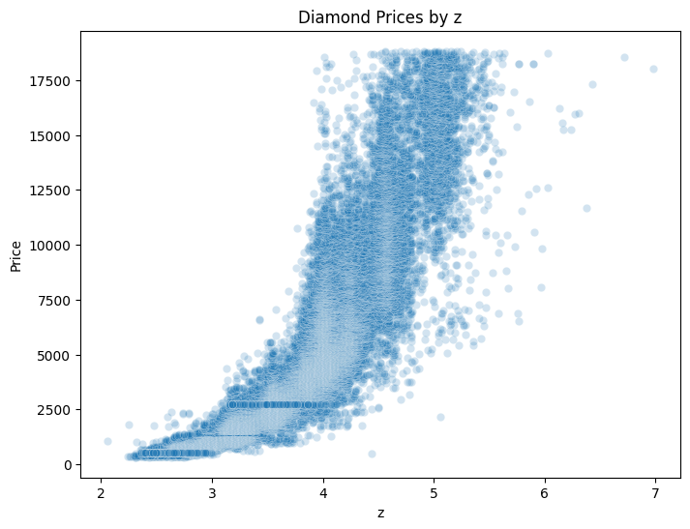
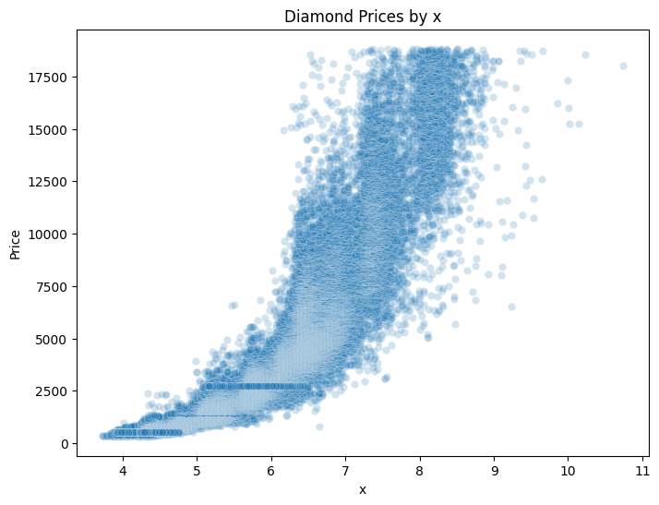
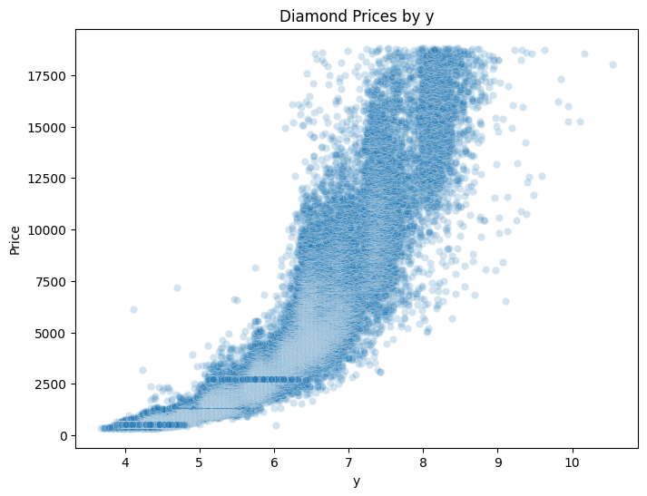
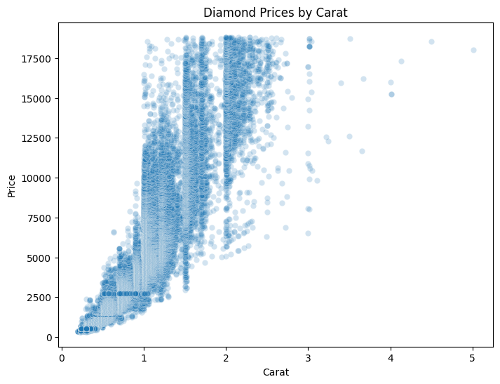
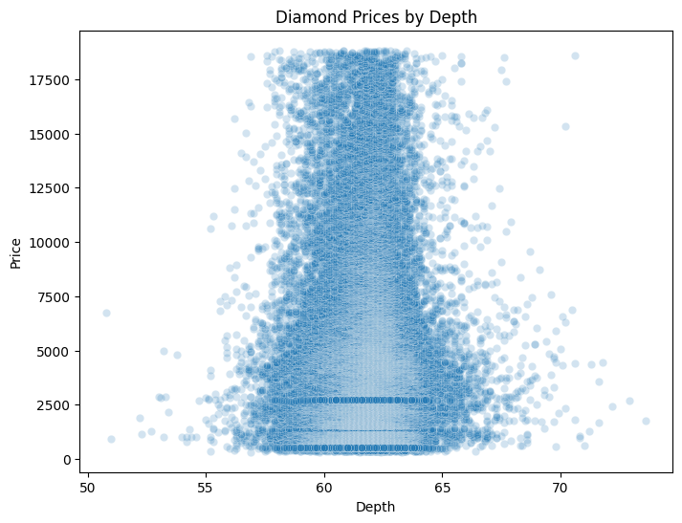
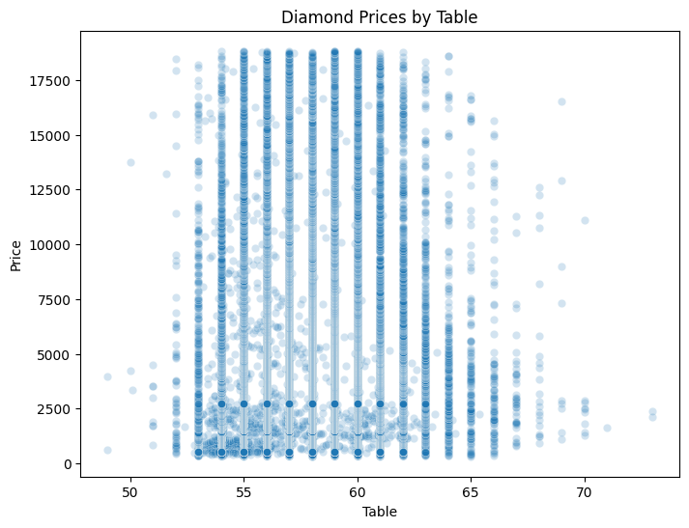
Price Distribution Across Numerical Features

Slide 9
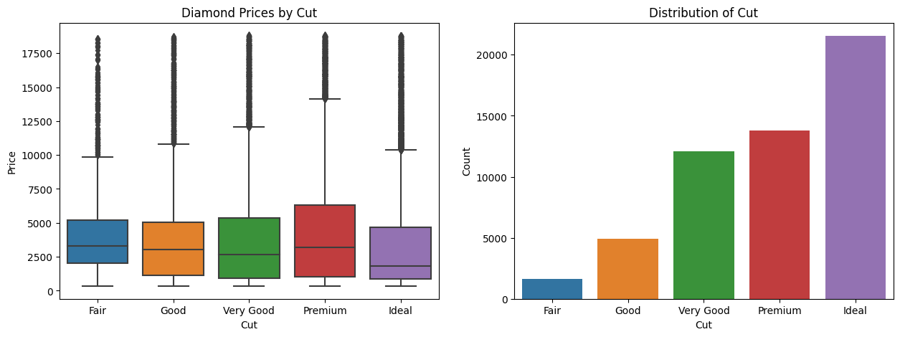
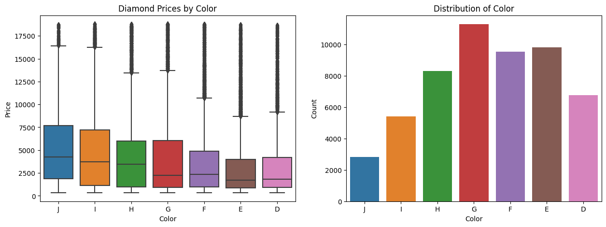
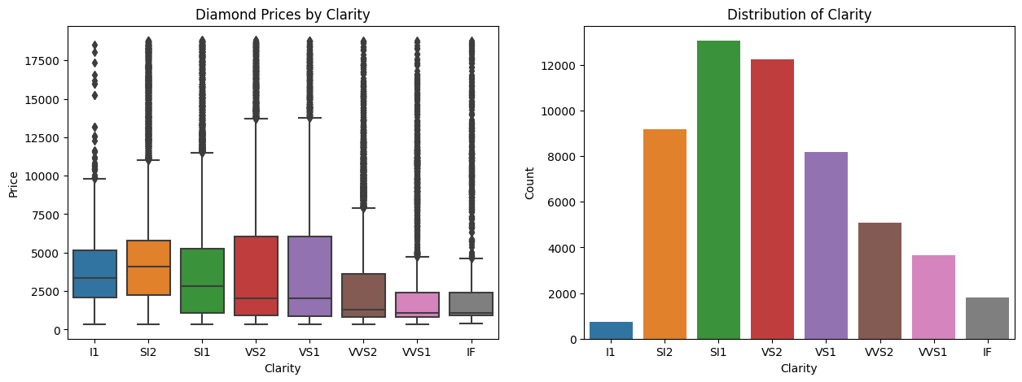
Price Distribution Across Categorical Features

Slide 10
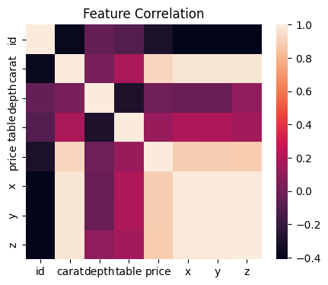
Feature Correlation

Slide 11
Notes
Numerical Data:
Depth and Table do not appear to be correlated to the price of the diamonds.
The price of diamonds appear to increase as X,Y,Z, and Carat increase.
Categorical Data:
The Premium diamond cut has the highest price. The most common cut in the dataset appears to be ideal.
Diamonds that have a color of J have the highest price. The most common color in the dataset is G.
The diamond clarity SI2 is the most expensive diamond. SI1 diamond is the one that appears the most often in the dataset.

Slide 12
Data Modeling

Slide 13
Data Modeling Steps
Get dummies for categorical features
1
Scale numerical features
2
Split into test and train set (80%/20%)
3
Create and compare several models using the following Metrics:
- R-Squared
- MSE
- Root Mean Squared Error
4

Slide 14
Model 1: Decision Tree
Model Advantages:
Can be used for classification and regression.
Robust to the presence of outliers.
Implicitly perform feature selection.
Easy to interpret.
Model Disadvantages:
Decision tree often involves higher time to train the model.
Models can become overly complicated and overfitted to the data.
Hyperparameters Considered:
max_depth
criterion

Slide 15
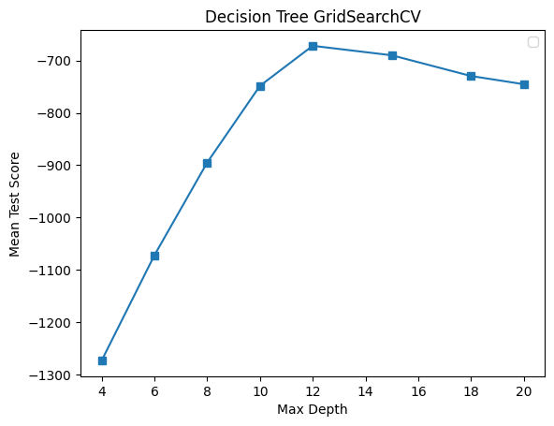
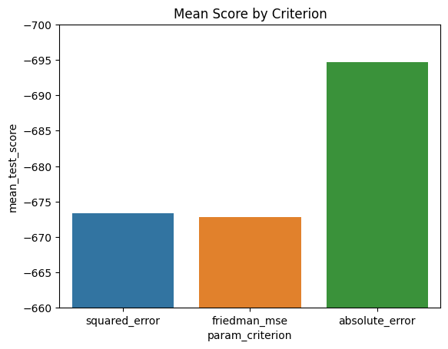
Model 1a Decision Tree – All Features
The optimal parameters for this model are:
max_depth = 12
criterion = friedman_mse

Slide 16
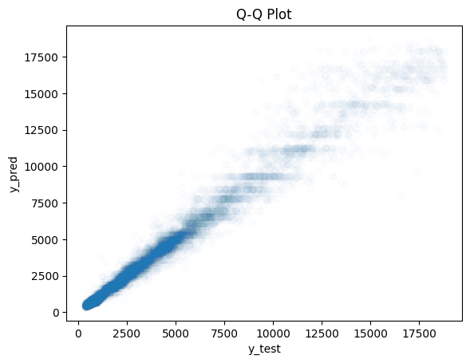
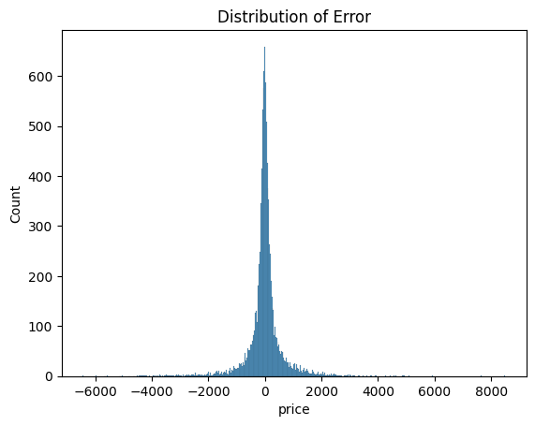
Model 1a: Final Model
Results of Model 1a:
Mean Squared Error: 468464.69751295017
Root Mean Squared Error: 684.4448096910007
R-Squared: 0.9705110816536835

Slide 17
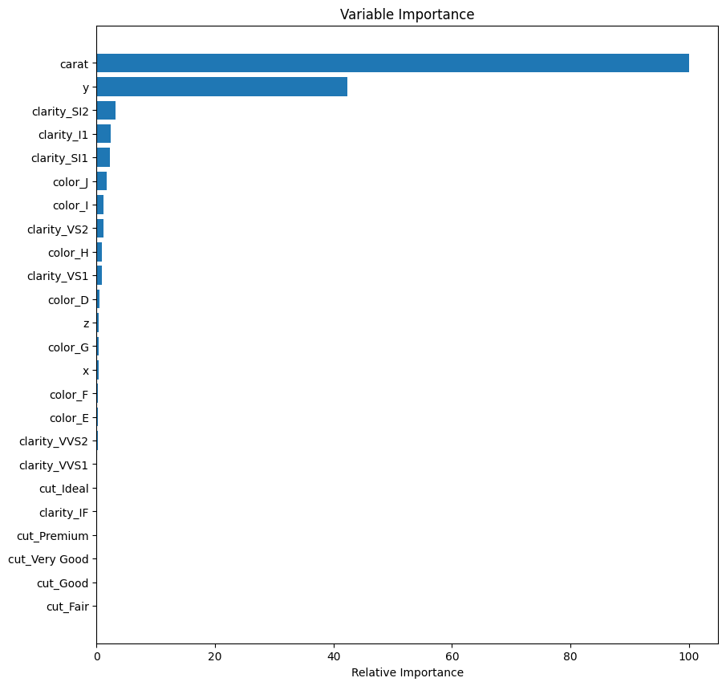
Feature Importance
As the model is giving feature importance to carat, y, color, and clarity, we will create a secondary dataset which keeps those features and remove all other features.

Slide 18
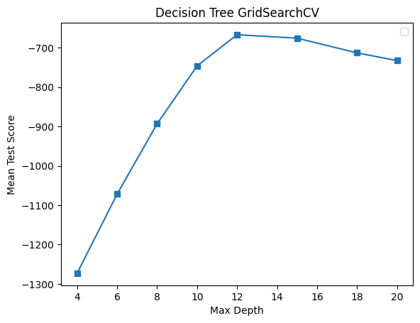
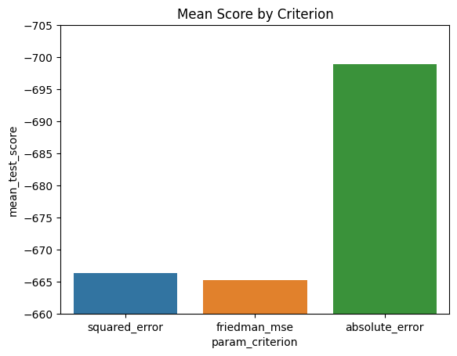
Model 1b Decision Tree – Select Features
The optimal parameters for this model are:
max_depth = 12
criterion = friedman_mse.

Slide 19
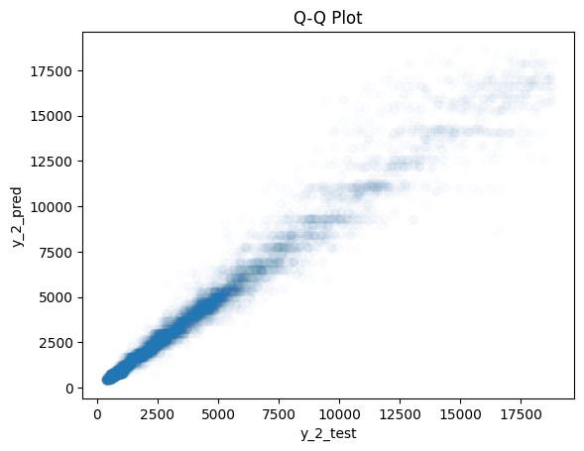
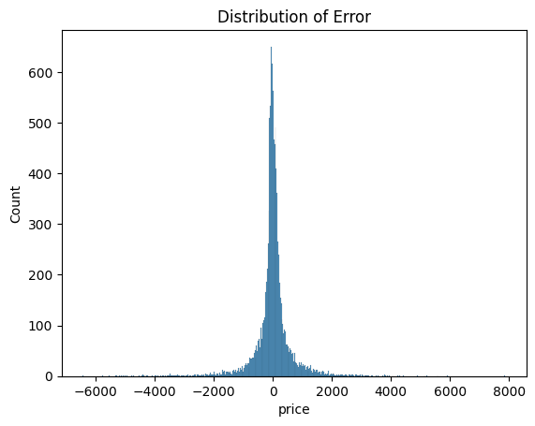
Model 1b: Final Model
Results of Model 1b:
Mean Squared Error: 469443.180084124
Root Mean Squared Error: 685.1592370275132
R-Squared: 0.970449488127431

Slide 20
Model 2: Random Forest Regressor
Model Advantages:
Same Advantages as Decision Tree.
Reduces overfitting of a single Decision Tree.
Model Disadvantages:
Requires increased training time and computational power.
Hyperparameters Considered:
max_depth
n_estimators
criterion

Slide 21
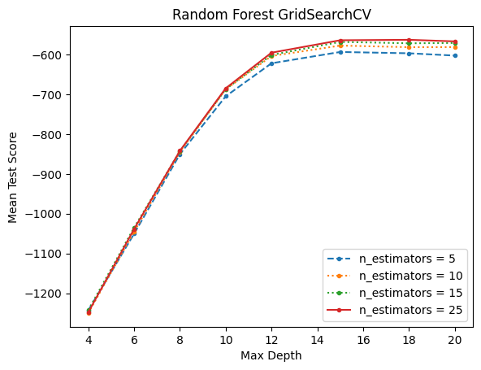
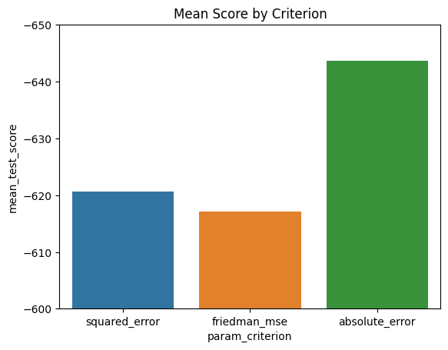
Model 2a Random Forest Regressor – All Features
The optimal parameters for this model are:
max_depth = 12
n_estimators = 5
criterion = friedman_mse

Slide 22

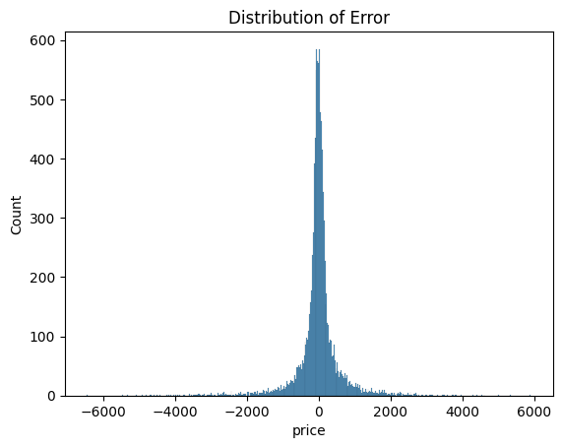
Model 2a: Final Model
Results of Model 2a:
Mean Squared Error: 405753.7038520396
Root Mean Squared Error: 636.9879934912742
R-Squared: 0.9744586136263181

Slide 23
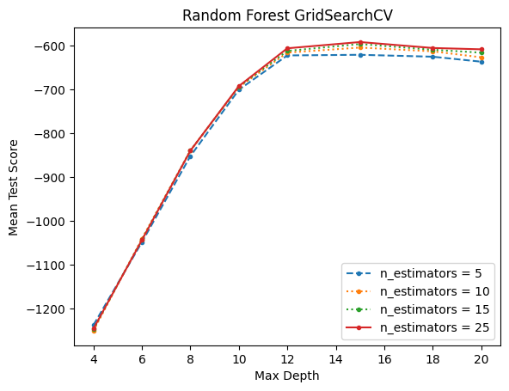
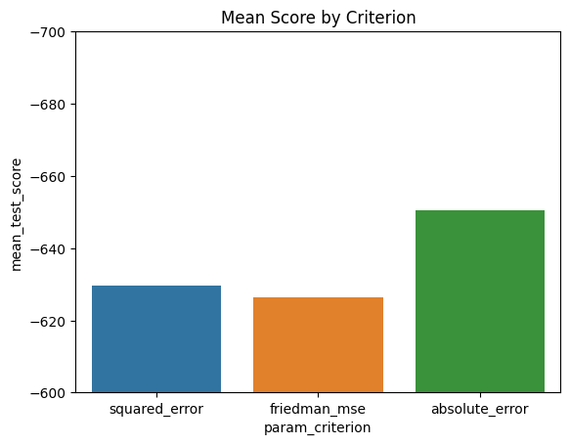
Model 2b Random Forest Regressor – Select Features
The optimal parameters for this model are:
max_depth = 12
n_estimators = 5
criterion = friedman_mse

Slide 24
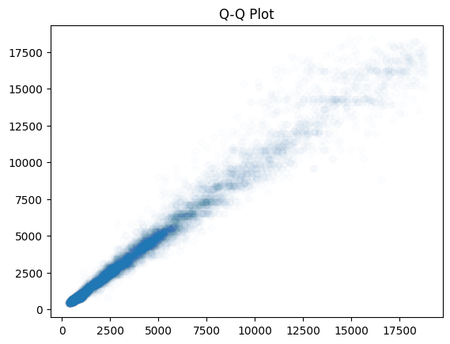
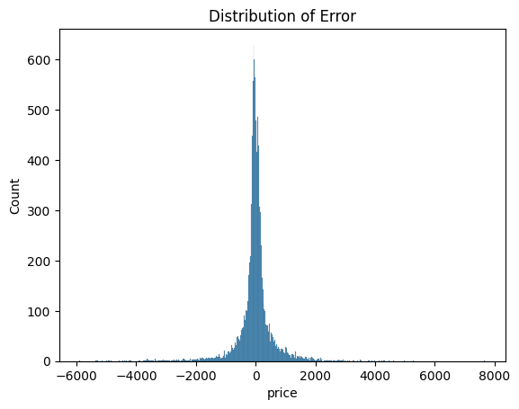
Model 2b: Final Model
Results of Model 2b:
Mean Squared Error: 425443.26102805894
Root Mean Squared Error: 652.2601176126431
R-Squared: 0.9732191952732997

Slide 25
Model 3: Nearest Neighbors Regression
Model Advantages:
Simple to understand and implement.
Can be used for classification and regression.
Has no statistical assumptions.
Model Disadvantages:
This is a slow algorithm.
Requires features to be scaled.
Very sensitive to outliers.
Hyperparameters Considered:
n_neighbors
p
algorithm

Slide 26
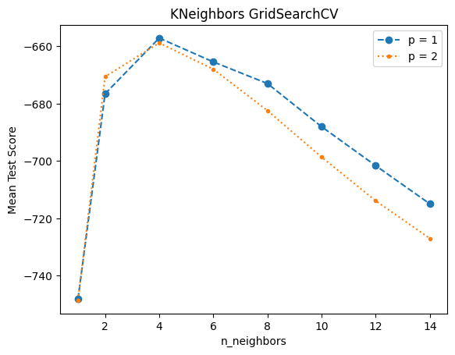
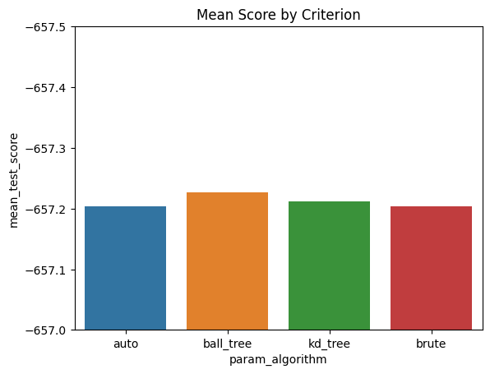
Model 3a Nearest Neighbors – All Features
The optimal parameters for this model are:
n_neighbors = 5
p = 1
algorithm = auto

Slide 27

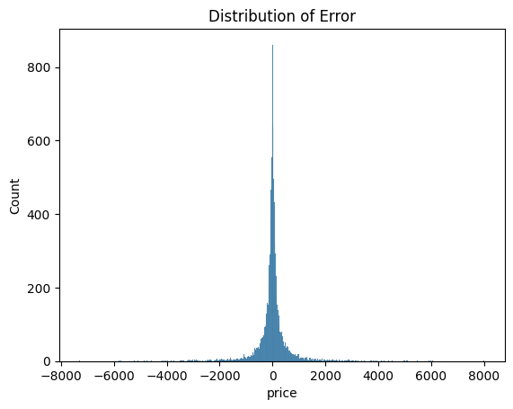
Model 3a: Final Model
Results of Model 3a:
Mean Squared Error: 420200.071870884
Root Mean Squared Error: 648.2284102620649
R-Squared: 0.9735492435730992

Slide 28
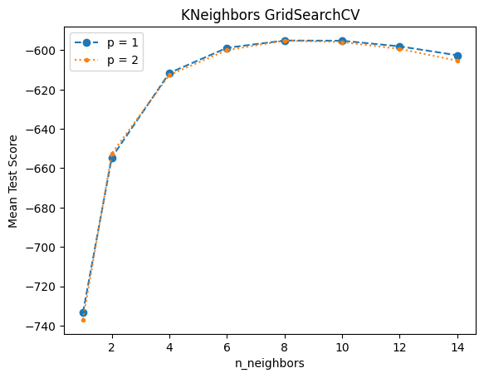
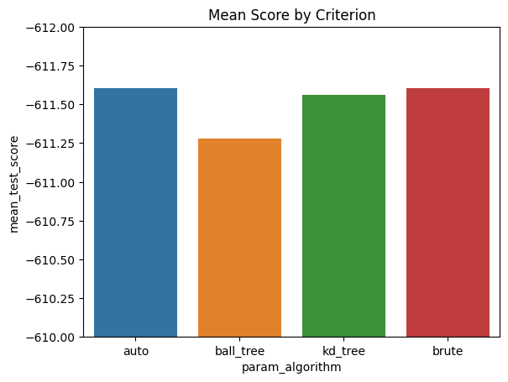
Model 3b Nearest Neighbors – Select Features
The optimal parameters for this model are:
n_neighbors = 5
p = 1
algorithm = ball_tree

Slide 29

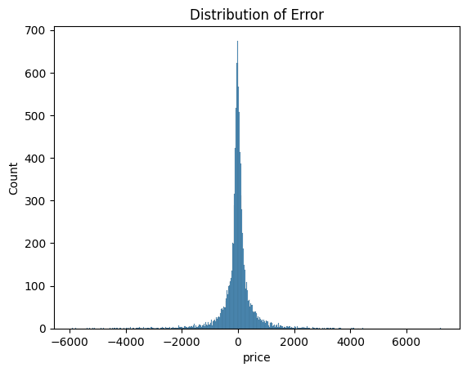
Model 3b: Final Model
Results of Model 3b:
Mean Squared Error: 365974.38603098044
Root Mean Squared Error: 604.958168827383
R-Squared: 0.9769626423425161

Slide 30
Best Model: Model 3b
Results of Model 3b:
Mean Squared Error: 365974.38603098044
Root Mean Squared Error: 604.958168827383
R-Squared: 0.9769626423425161

Slide 31

Assumptions, Limitations, and Disclaimers
We are assuming that there are no other factors that affect diamond prices other than the features that are included in the dataset.
A limitation of this model is that it is using a static dataset of diamonds and their prices. In reality, diamond prices are constantly fluctuating so this model could become outdated.
An additional limitation is, we are only including US diamond data in this analysis.

Slide 32
Recommendations
This model can be used in the following ways:
Diamond companies and jewelers can use this model in order to determine the appropriate pricing for the diamonds that they are selling.
Consumers can use this model in order to evaluate whether they’re getting a good deal when purchasing a diamond.

Slide 33
Next Steps
In order to improve the model, I would consider frequently retraining this model on current data, as diamond prices can fluctuate. Ideally, I could use Online learning to do this.

Slide 34
Thank you!

